Slide 1
JSP (Java Server Pages)

Slide 2
Contents
The Problem with Servlet
The Anatomy of a JSP Page
JSP Processing
JSP Application Development
Generating Dynamic Content
Using Scripting Elements
Implicit JSP Objects
Declaring Variables and Methods
Sharing Data Between JSP pages
Users Passing Control and Data between Pages
JSP application design with JDBC
JSP Application Design with MVC.

Slide 3
The Problem with Servlet
In many Java servlet-based applications, processing the request and generating the response are both handled by a single servlet class
Using servlets, Java programming is required to develop and maintain all aspects of the application
Changing the look and feel of the application by adding modifications to the existing servlet requires the servlet code to be recompiled.
Writing complex business logic makes the application difficult to understand
Both presentation layer and business logic layer put together in Servlets.
web.xml is mandatory in Servlets.
JSP needs no compilation by the Programmer.
Incase of Servlets, the Programmer compiles manually a Servlet file and deploys a .class file in server.

Slide 4
Introduction to JSP
JSP is a server side technology that does all the processing at server.
JSP is used for creating dynamic web applications, using java as programming language.
A JSP page consists of HTML tags and JSP tags.
JSP has both presentation logic as well as business logic.
In JSP, you can embed Java code in HTML using JSP tags
most of which start with <% an ends with ( here java code)%>.
Released in 1999 by Sun Microsystems,
JSP is similar to PHP and ASP, but it uses the Java programming language

Slide 5
Cont …
JSP pages are easier to maintain then a Servlet.
JSP pages are opposite of Servlets as a servlet adds HTML code inside Java code, while JSP adds Java code inside HTML using JSP tags.
Using JSP, you can collect input from users through Webpage forms, present records from a database or another source, and create Webpages dynamically.
JSP tags can be used for a variety of purposes, such as
retrieving information from a database
accessing JavaBeans components,
passing control between pages,
and sharing information between requests, pages etc.

Slide 6
Why JSP is preferred over servlets?
JSP provides an easier way to code dynamic web pages.
JSP does not require additional files like, java class files, web.xml etc
Any change in the JSP code is handled by Web Container(Application server like tomcat), and doesn't require re-compilation.
Both presentation layer and business logic layer put together in Servlets.
In JSP, they can be separated with the usage of JavaBeans.
JSP pages can be directly accessed, and web.xml mapping is not required like in servlets.
JSP needs no compilation by the Programmer.
Programmer deploys directly a JSP source code file in server where as incase of Servlets, the Programmer compiles manually a Servlet file and deploys a .class file in server.

Slide 7
Difference b/w servlets & Jsp
SERVLET
JSP
Servlet is a java code.
Writing code for servlet is harder than JSP as it is html in java.
Servlet plays a controller role in MVC approach.
Servlet is faster than JSP.
JSP is a html based code.
JSP is easy to code as it is java in html.
JSP is the view in MVC approach for showing output.
JSP is slower than Servlet because the first step in JSP lifecycle is the translation of JSP to java code and then compile.

Slide 8
Servlet can accept all protocol requests.
In Servlet, we can override the service() method.
In Servlet by default session management is not enabled, user have to enable it explicitly
In Servlet we have to implement everything like business logic and presentation logic in just one servlet file.
JSP only accept http requests
In JSP, we cannot override its service() method
In JSP session management is automatically enabled.
In JSP business logic is separated from presentation logic by using javaBeans.

Slide 9
Example
<%-- JSP comment --%>
<HTML> <HEAD>
<TITLE>MESSAGE</TITLE> </HEAD>
<BODY>
<%out.print("Hello, Sample JSP code");%>
</BODY> </HTML>

Slide 10
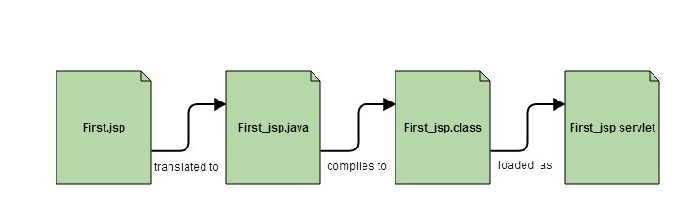
JSP Processing
The web server have JSP engine (container) to process JSP pages.
All the requests for JSP Pages are handled by JSP Container.
JSP pages are converted into Servlet by the Web Container.
The Container translates a JSP page into servlet class source(.java) file and then compiles into a Java Servlet class.

Slide 11
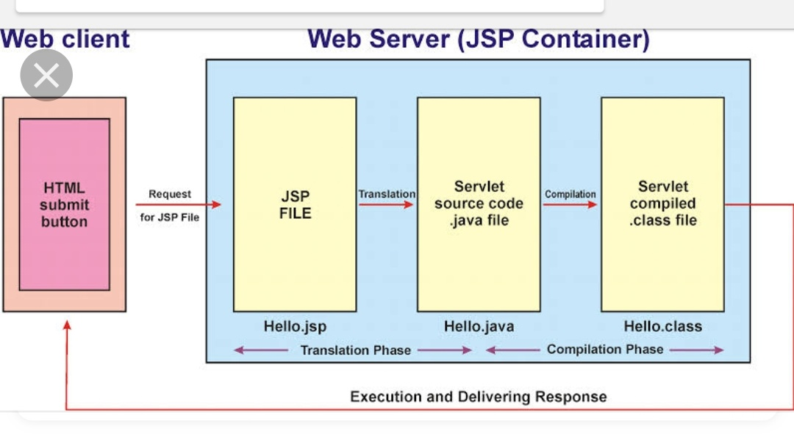

Slide 12
Cont …
Web browser sends an HTTP request to the web server requesting JSP page.
Web server recognizes that the HTTP request by web browser is for JSP page by checking the extension of the file (i.e .jsp)
Web server forwards HTTP Request to JSP engine.
JSP engine loads the JSP page from disk and converts it into a servlet
JSP engine then compiles the servlet into an executable class and forward original request to a servlet engine.
Servlet engine loads and executes the Servlet class.
Servlet produces an output in HTML format
Output produced by servlet engine is then passes to the web server inside an HTTP response.
Web server sends the HTTP response to Web browser in the form of HTML content.
Web browser loads the page into the browser and thus user can view the dynamically generated page.

Slide 13
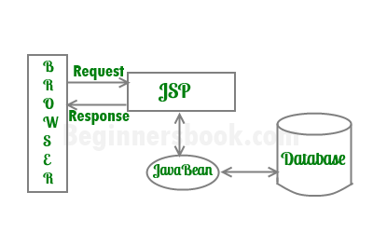
Architecture of a JSP Application…

Slide 14
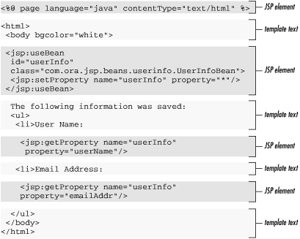
The Anatomy of a JSP Page

Slide 15
Cont …
A JSP page is simply a regular web page with JSP elements for generating the parts of the page that differ for each request
Everything in the page that is not a JSP element is called template text .
Template text can really be any text: HTML, XML, or even plain text.
When a JSP page request is processed, the template text and the dynamic content generated by the JSP elements are merged, and the result is sent as the response to the browser.

Slide 16
Cont …
The jsp:useBean action instantiates an instance of the bean class
The id is the access name of this bean.
<jsp:setProperty is used to assign values to properties of a bean.
Ex:
<jsp:setProperty name="myBook" property="price" value=30 />
jsp:getProperty Action Element retrieves the value of a bean property, converts it to a string, and inserts it into the JSP outputs.
Ex:
<jsp:getProperty name="myBook" property="price“/>

Slide 17
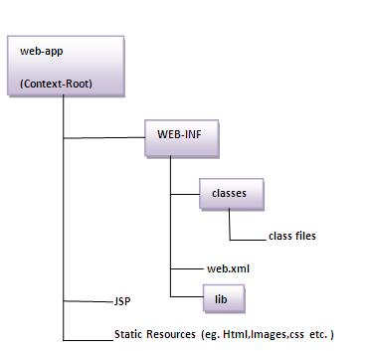
Directory structure of JSP
The directory structure of JSP page is same as servlet. We contains the jsp page outside the WEB-INF folder or in any directory.
Localhost:8080/Dirname/name.jsp

Slide 18
JSP Scripting Elements
The scripting elements are used to insert java code inside the jsp.
There are three types of scripting elements:
scriptlet tag
expression tag
declaration tag

Slide 19
JSP scriptlet tag
In JSP, java code can be written inside the jsp page using the scriptlet tag
Scriptlet Tag allows you to write java code inside JSP page
Syntax:
<% java source code %>
Ex:
<html>
<body>
<% out.print("welcome to jsp"); %>
</body>
</html>

Slide 20
Index.html welcome.jsp
<html>
<body>
<form action="welcome.jsp">
<input type="text" name="uname">
<input type="submit" value="go"><br/>
</form>
</body>
</html>
Out put: welcome CSE
<html>
<body>
<%
String name=request.getParameter("uname"); out.print("welcome "+name); %>
</body>
</html>

Slide 21
JSP Expression tag
Expression tag evaluates the expression placed in it, converts the result into String and send the result back to the client through response object.
Basically it writes the result to the client(browser).
So you need not write out.print() to write data.
It is mainly used to print the values of variable or method.
<%= used to specify the Expression tag
Syntax
<%= statement %>
Ex:
<html> <body>
<%= "welcome to jsp" %>
</body> </html>

Slide 22
Example of JSP expression tag that prints current time & date
<HTML>
<BODY>
Hello ! CSE Students
<br>
Current time is: <%=new java.util.Date()%>
</BODY>
</HTML>
Output:
Hello ! CSE Students Current time is: Sun Oct 29 10:50:04 IST 2019

Slide 23
Example of JSP expression tag that prints the user name
<html>
<body>
<form action="welcome.jsp">
<input type="text" name="uname">
<input type="submit" value="go"><br/></form>
</body>
</html>
Out put: welcome CSE
<html>
<body>
<%= "Welcome "+request.getParameter("uname") %> </body>
</html>

Slide 24
Declaration Tag (or) Declaring Variables and Methods
Declaration tag is a block of java code for declaring class wide variables, methods.
The JSP declaration tag is used to declare variables and methods.
<%! Is used to specify declaration.
Syntax
<%! field or method declaration %>
Ex:
<html> <body>
<%! String name="Neha"; %>
<%! int age=5; %>
<%= "Name is: "+ name %><br>
<%= "AGE: "+ age %>
</body> </html>

Slide 25
Example of JSP declaration tag that declares method
<html>
<body>
<%!
int cube(int n){
return n*n*n;
}
%>
<%= "Cube of 3 is:" +cube(3) %>
</body>
</html>

Slide 26
Jsp Implicit Objects (for reference:https://www.guru99.com/jsp-implicit-objects.html)
Jsp objects are created by JSP Engine during translation phase (while translating JSP to Servlet).
There are total 9 implicit objects available in JSP.
out
request
response
config
application
session
pageContext
page
exception

Slide 27
Jsp Implicit Objects
Out:
Out is one of the implicit objects to write the data to the buffer and send output to the client in response
Out is object of jspWriter class
Request:
The request object is an instance of java.servlet.http.HttpServletRequest.
It will be created by container for every request.
It will be used to request the information like parameter, header information , server name, etc.
It uses getParameter() to access the request parameter.

Slide 28
Jsp Implicit Objects
Response:
"Response" is an instance of class which implements HttpServletResponse interface
"Response object" will be created by the container for each request.
It represents the response that can be given to the client
The response implicit object is used to content type, add cookie and redirect to response page
void sendRedirect(String address) – It redirects the control to a new JSP page
response.sendRedirect("http://beginnersbook.com");

Slide 29
Jsp Implicit Objects
Config:
Config is of the type java.servlet.servletConfig
It is created by the container for each jsp page
It is used to get the initialization parameter in web.xml
Application :
Application object is an instance of javax.servlet.ServletContext
This is used for getting application-wide initialization parameters and to maintain useful data across whole JSP application.
Application object is created by container one per application, when the application gets deployed.

Slide 30
Jsp Implicit Objects
Session
The session is holding "httpsession" object
Session object is used to get, set and remove attributes to session scope and also used to get session information
pageContext:
It is an instance of javax.servlet.jsp.PageContext
It is used for accessing page, request, application and session attributes.
Exception:
Exception implicit object is used in exception handling for displaying the error messages

Slide 31
Index.html check.jsp
<html>
<body>
<%
String uid=request.getParameter("id");
String password=request.getParameter("pass");
session.setAttribute("session-uid", uid);
if(uid.equals(“cse") && password.equals(“123"))
{
response.sendRedirect("success.jsp");
}
else
{
response.sendRedirect("failed.jsp");
}
%>
</body> </html>
<html>
<head>
<title>Login Page</title>
</head>
<body>
<form action="check.jsp">
UserId: <input type="text" name="id" /> <br>
Password: <input type="text" name="pass" /> <br>
<input type="submit" value="Sign In!!"/>
</form>
</body>
</html>

Slide 32
success.jsp failed.jsp
<%@page contentType="text/html" pageEncoding="UTF-8"%>
<html>
<body>
<h1 style=color:blue>Hi cse U have Successfully login on </h1>
<h2 style=color:red> <%=new java.util.Date()%></h2>
</body>
</html>
<%@page contentType="text/html" pageEncoding="UTF-8"%>
<html>
<body>
<h1>U have Failed!</h1>
</body>
</html>

Slide 33
JSP directives
Directives control the processing of an entire JSP page.
It gives directions to the server regarding processing of a page.
Syntax of Directives:
<%@ directive name [attribute name=“value” attribute name=“value” ........]%>
There are three types of Directives in JSP:
1) Page Directive 2) Include Directive 3) TagLib Directive

Slide 34
Page Directive
The Page directive defines a number of page dependent properties which communicates with the Web Container at the time of translation.
Basic syntax of using the page directive is
<%@ page attribute="value" %>
Some of the attributes are
import attribute
language attribute
contentType attribute

Slide 35
Page Directive
import:
This attribute is used to import packages.
Syntax : <%@page import="value"%>
language :
language attribute defines scripting language to be used in the page.
Syntax : <%@ page language="value"%>
contentType:
This attribute is used to set the content type of a JSP page.
Default value: text/html

Slide 36
2) Include Directive
Include directive is used to copy the content of one JSP page to another.
It’s like including the code of one file into another.
<%@include file ="value"%>
here value is the JSP file name which needs to be included.
If the file is in the same directory then just specify the file name otherwise complete URL(or path) needs to be mentioned in the value field.
Note: It can be used anywhere in the page.
Example:
<%@include file="myJSP.jsp"%>

Slide 37
include.jsp declaration.jsp
<html>
<body>
<%@ include file="declaration.jsp" %>
<%=name %>
Use this page on : <%=new java.util.Date()%>
</body>
</html>
<html> <body>
<%! String name="Neha"; %>
<%! int age=5; %>
</body> </html>

Slide 38
JSP Taglib
The JSP taglib directive is used to define a tag library that defines many tags.
We use the TLD (Tag Library Descriptor) file to define the tags
Syntax JSP Taglib directive
%@taglib uri ="taglibURI" prefix="tag prefix"%>
Where URI is uniform resource locator, which is used to identify the location of custom tag and tag prefix is a string which can identify the custom tag in the location identified by uri.
Example:
<%@ taglib uri="http://www.sample.com/mycustomlib" prefix="demotag" %>
<html> <body>
<demotag:welcome/>
</body> </html>

Slide 39
Sharing Data Between JSP Pages
Any real application consists of more than a single page, and multiple pages often need access to the same information and server-side resources.
When multiple pages process the same request (e.g., one page that retrieves the data the user asked for and another that displays it), there must be a way to pass data from one page to another.
To make this happen, you need to be able to do two things:
Pass control from one page to another
Pass data from one page to another

Slide 40
Passing Control between Pages
<jsp:forward> action tag is used for forwarding a request or control to the another resource (It can be a JSP, html or Servlet).
Request can be forwarded with or without parameter.
The <jsp:forward> action stops processing of one page and starts processing the page specified by the page attribute instead, called the target page.
The control never returns to the original page.
The target page has access to all information about the request, including all request parameters.
You can also add additional request parameters when you pass control to another page by using <jsp:param> action elements

Slide 41
Cont …
Forwarding along with parameters:
<jsp:forward page="URL_of_Page" />
<jsp:param name=“ ” value=“ ” />
<jsp:param name=“ ” value=“ ” />
</jsp:forward>
Forwarding without parameters:
<jsp:forward page="URL_of_Page" />

Slide 42
index.jsp display.jsp
<html>
<body>
<jsp:forward page="display.jsp">
<jsp:param name="name" value=“cse" />
</jsp:forward>
</body>
</html>
<html>
<body>
<h2>Hello this is a display.jsp Page</h2>
My name is: <%=request.getParameter("name") %><br>
</body>
</html>

Slide 43
Pass data from one page to another
Session object is used to pass the data from one jsp page to other .
setAttribute(String, object) :
This method is used to save an object in session by assigning a unique string to the object.
getAttribute(String name):
The object stored by setAttribute method is fetched from session using getAttribute method.

Slide 44
index.html one.jsp
<html>
<body>
<form action="one.jsp">
Name: <input type="text" name="name">
Age:<input type="text" name="age"/>
<input type="submit" value="Go"/>
</form>
</body>
</html>
<html>
<body>
<%
String NAME=request.getParameter("name");
String AGE=request.getParameter("age");
session.setAttribute("SES_NAME",NAME);
session.setAttribute("SES_AGE",AGE);
%>
<jsp:forward page="two.jsp"/>
</body>
</html>

Slide 45
two.jsp
<html>
<body>
<%
String name=(String)session.getAttribute("SES_NAME");
String age=(String)session.getAttribute("SES_AGE");
%>
<h1><%="name is:"+name %></h1>
<h1><%="age is:"+age%></h1>
</body>
</html>

Slide 46
JSP application design with JDBC
Signup.html
<html>
<body bgcolor=pink>
<table align=center>
<form method="POST" action="Signupjsp.jsp">
<tr>
<td>Name</td><td><input type="text" name="name"/></td>
</tr>
<tr>
<td>UserName</td><td><input type="text" name="uname"/></td>
</tr><tr>
<td>Password</td><td><input type="password" name="pword"/><td>
</tr>
<tr>
<td>email</td><td><input type="text" name="email"/><td>
</tr>
<tr>
<td>mobile</td><td><input type="text" name="mobile"/></td>
</tr>
<tr>
<td></td><td><input type="submit" value="submit"/></td>
</tr>
</table>
</form>
</body></html>

Slide 47
Signup.jsp
<html>
<body>
<table>
<%@ page import="java.util.*" %>
<%@ page import="java.sql.*;" %>
<%@ page import="java.io.*;" %>
<%
response.setContentType("text/html");
String name=request.getParameter("name");
String uname=request.getParameter("uname");
String pass=request.getParameter("pword");
String email=request.getParameter("email");
long mobile=Long.parseLong
(request.getParameter("mobile"));
try{
Class.forName("com.mysql.jdbc.Driver");
Connection con=DriverManager.getConnection
("jdbc:mysql://localhost/IIICSE","root","root");
Statement stmt=con.createStatement();
int i=stmt.executeUpdate(
"insert into signup values('"+name+"','"+uname+"',"
+ "'"+pass+"','"+email+"',"+mobile+")");
if(i>0)
response.sendRedirect("login.html");
else
out.print("Insert Unsuccessful");
}
catch (Exception e) {
out.print(e);
}
out.close();
%>

Slide 48
Login.html
<html>
<body bgcolor=pink>
<table align=center>
<form method="POST" action="loginjsp.jsp">
<td>UserName</td><td><input type="text" name="uname"/></td>
</tr>
<tr>
<td>Password</td><td><input type="password" name="pword"/><td>
</tr>
<tr>
<td></td><td><input type="submit" value="Login"/></td>
</tr>
</table>
</form>
</body>
</html>

Slide 49
login.jsp
<html>
<body>
<table>
<%@ page import="java.util.*" %>
<%@ page import="java.sql.*" %>
<%@ page import="java.io.*;" %>
<%
response.setContentType("text/html");
String uname=request.getParameter("uname");
String pass=request.getParameter("pword");
try{
Class.forName("com.mysql.jdbc.Driver");
Connection con=DriverManager.getConnection("jdbc:mysql://localhost/IIICSE","root","root");
PreparedStatement ps= con.prepareStatement("Select uname,password from signup where uname=? and password=?");
ps.setString(1, uname);
ps.setString(2, pass);
ResultSet rs=ps.executeQuery();
if (rs.next()) {
response.sendRedirect("home.html");
}
else {
response.sendRedirect("login.html");
}
}
catch(Exception e) {
out.print(e);
}
%>

Slide 50
JSP program to store employee details sent from registration form in to database table.
emp.html
<html>
<body>
<h3><center>Employee Registration Form</center></h3>
<form method="POST“ action="http://localhost:8080/employee/employee">
<table align="center">
<tr>
<td>Eid:</td>
<td><input type="text"name="eid"/></td>
</tr>
<tr>
<td>Ename:</td>
<td><input type="text"name="ename"/></td>
</tr> <tr>
<td>phno:</td>
<td><input type="text"name="ephno"/></td>
</tr>
<tr>
<td>Address:</td>
<td><input type="text"name="eaddress"/></td>
</tr>
<tr>
<td>email:</td>
<td><input type="text"name="email"/></td>
</tr>
<tr>
<td>Salary:</td>
<td><input type="text"name="esalary"/></td>
</tr>
<tr>
<td></td><td><input type="submit" value="submit"/></td>
<td><input type="reset" value="Reset"/></td></tr>
</table></form></body></html>

Slide 51
emp.jsp
import java.io.*;
import java.util.*;
import java.sql.*;
import javax.servlet.*;
import javax.servlet.http.*;
public class employee extends HttpServlet
{
public void doPost(HttpServletRequest request,HttpServletResponse response)throws IOException,ServletException
{
response.setContentType("text/html");
PrintWriter out=response.getWriter();
String eid=request.getParameter("eid");
String ename=request.getParameter("ename");
String ephno=request.getParameter("ephno");
String eaddress=request.getParameter("eaddress");
String email=request.getParameter("email");
String esalary=request.getParameter("esalary");
try
{
Class.forName("com.mysql.jdbc.Driver");
Connection con=DriverManager.getConnection("jdbc:mysql: //localhost/employee","root","root");
PreparedStatement ps=con.prepareStatement("insert into employee values(?,?,?,?,?,?)");
ps.setString(1,eid);
ps.setString(2,ename);
ps.setString(3,ephno);
ps.setString(4,eaddress);
ps.setString(5,email);
ps.setString(6,esalary);
int i=ps.executeUpdate();
if(i>0)
{
response.sendRedirect("employeesalary.html");
}
else
{
out.println("Not inserted");
}
}
catch(Exception e)
{
} }}

Slide 52
JSP Application Design with MVC.
Reenskaug formulated the model–view–controller (MVC) pattern for graphical user interface (GUI) software design in 1979 while visiting the Xerox Palo Alto Research Center (PARC)
This model has since been used for GUI applications developed in all popular programming languages.
MVC is an architecture that separates business logic, presentation and data
In MVC, M stands for Model, V stands for View,C stands for controller.
MVC is a systematic way to use the application where the flow starts from the view layer, where the request is raised and processed in controller layer and sent to model layer to insert data and get back the success or failure message.

Slide 53
Model Layer
This is the data layer which consists of the business logic of the system.
It consists of all the data of the application.
It consists of JavaBeans, EJB, etc. into it.
It consists of classes which have the connection to the database.
The controller connects with model and fetches the data and sends to the view layer.
The model connects with the database as well and stores the data into a database which is connected to it.

Slide 54
View Layer
This is a presentation layer.
It consists of HTML, JSP, etc. into it.
It normally presents the UI of the application.
It is used to display the data which is fetched from the controller which in turn fetching data from model layer classes.
This view layer shows the data on UI of the application.

Slide 55
Controller Layer:
It acts as an interface between View and Model.
It intercepts all the requests which are coming from the view layer.
It receives the requests from the view layer and processes the requests and does the necessary validation for the request.
This requests is further sent to model layer for data processing, and once the request is processed, it sends back to the controller with required information and displayed accordingly by the view.

Slide 56
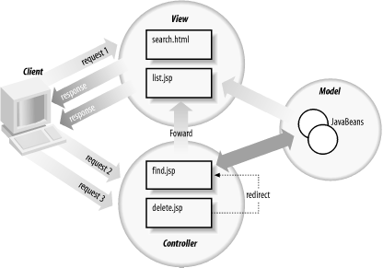
MVC roles in a pure JSP scenario

